Slide 1
Conventional Wisdom #5
Government spending stimulates the economy.
1
Notes:
Conventional wisdom versus the data

Slide 2




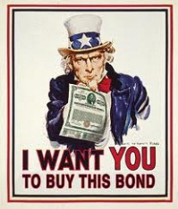





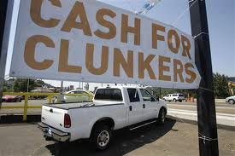


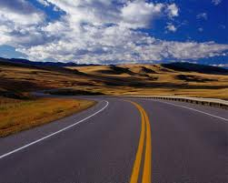
Total (net) stimulus = $3 trillion
Federal Reserve = $1,500 b.
TARP = $356 b.
Financial Initiatives = $366 b.
Housing Initiatives = $130 b.
Stimulus = $578 b.
Data source: http://www.money.cnn.com/news/storysupplement/economy/bailouttracker/
2
Notes:
This was the argument for the various stimulus packages. TARP (bailout investment banks and car companies), Federal Reserve Rescue efforts (Bear Stearns, Fannie and Freddie, the Government, and many banks), the “official” stimulus package (infrastructure, student loan guarantees, cash for clunkers), miscellaneous financial and housing initiatives. Total stimulus = $3 trillion. Unemployment rate went from 5% before the stimulus to 10% after. Counterargument: It would have been worse without the stimulus spending.

Slide 3
Historically, how has the economy reacted
to stimulus spending?
3

Slide 4
Stimulus Spending and Economic Growth
If stimulus spending worked, we should see a relationship like this:
4

Slide 5
Stimulus Spending and Economic Growth (1954.1 to 2011.1)
Increased government spending does not appear to increase economic activity.
Data source: Bureau of Economic Analysis, National Income and Product Accounts
5

Slide 6
Maybe stimulus spending doesn’t
have an immediate effect.
What is the effect over time?
6

Slide 7
Stimulus Spending and Economic Growth (1954.1 to 2011.1)
Increased government spending does not appear to increase economic activity one year in the future.
Data source: Bureau of Economic Analysis, National Income and Product Accounts
7

Slide 8
Stimulus Spending and Economic Growth (1954.1 to 2011.1)
Increased government spending does not appear to increase economic activity two years in the future.
Data source: Bureau of Economic Analysis, National Income and Product Accounts
8

Slide 9
Maybe stimulus spending’s effects are cumulative.
What is the cumulative effect?
9

Slide 10
Stimulus Spending and Economic Growth (1954.1 to 2011.1)
Increased government spending appears to have a negative cumulative effect over 8 quarters.
Data source: Bureau of Economic Analysis, National Income and Product Accounts
10

Slide 11
Conventional Wisdom #5
Government spending stimulates the economy.
Data: The Keynes-was-wrong-and-that’s-why-we-don’t-teach-him-anymore Rule:
On average, government spending suppresses the economy.
http://www.antonydavies.org/
Notes:
Conventional wisdom versus the data

